Slide 1
Session – 24
CMMI and Six Sigma

Slide 2
Capability Maturity Model Integration
Capability Maturity Model Integration (CMMI), a comprehensive process meta-model that is predicated on a set of system and software engineering capabilities that should be present as organizations reach different levels of process capability and maturity.
The CMMI represents a process meta-model in two different ways: (1) as a “continuous” model and (2) as a “staged” model.

Slide 3
Levels of CMMI
Each process area (e.g., project planning or requirements management) is formally assessed against specific goals and practices and is rated according to the following capability levels:
Level 0: Incomplete
Level 1: Performed
Level 2: Managed
Level 3: Defined
Level 4: Quantitatively managed
Level 5: Optimized
The CMMI defines each process area in terms of “specific goals” and the “specific practices” required to achieve these goals. Specific goals establish the characteristics that must exist if the activities implied by a process area are to be effective. Specific practices refine a goal into a set of process-related activities.

Slide 4
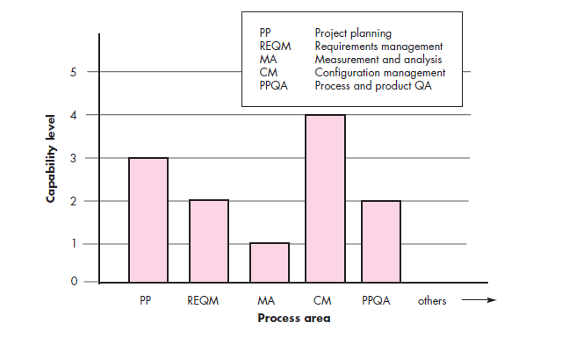
CMMI Process Area Capability Profile

Slide 5
Specific Goals of CMMI
associated specific practices (SP) defined for project planning are:
SG 1 Establish Estimates
SP 1.1-1 Estimate the Scope of the Project
SP 1.2-1 Establish Estimates of Work Product and Task Attributes
SP 1.3-1 Define Project Life Cycle
SP 1.4-1 Determine Estimates of Effort and Cost
SG 2 Develop a Project Plan
SP 2.1-1 Establish the Budget and Schedule
SP 2.2-1 Identify Project Risks
SP 2.3-1 Plan for Data Management
SP 2.4-1 Plan for Project Resources
SP 2.5-1 Plan for Needed Knowledge and Skills
SP 2.6-1 Plan Stakeholder Involvement
SP 2.7-1 Establish the Project Plan
SG 3 Obtain Commitment to the Plan
SP 3.1-1 Review Plans That Affect the Project
SP 3.2-1 Reconcile Work and Resource Levels
SP 3.3-1 Obtain Plan Commitment

Slide 6
CMMI also defines a set of five generic goals
The generic goals (GG) and practices (GP) for the project planning process area are:
GG 1 Achieve Specific Goals
GP 1.1 Perform Base Practices
GG 2 Institutionalize a Managed Process
GP 2.1 Establish an Organizational Policy
GP 2.2 Plan the Process
GP 2.3 Provide Resources
GP 2.4 Assign Responsibility
GP 2.5 Train People
GP 2.6 Manage Configurations
GP 2.7 Identify and Involve Relevant Stakeholders
GP 2.8 Monitor and Control the Process
GP 2.9 Objectively Evaluate Adherence
GP 2.10 Review Status with Higher-Level Management

Slide 7
GG 3 Institutionalize a Defined Process
GP 3.1 Establish a Defined Process
GP 3.2 Collect Improvement Information
GG 4 Institutionalize a Quantitatively Managed Process
GP 4.1 Establish Quantitative Objectives for the Process
GP 4.2 Stabilize Subprocess Performance
GG 5 Institutionalize an Optimizing Process
GP 5.1 Ensure Continuous Process Improvement
GP 5.2 Correct Root Causes of Problems

Slide 8
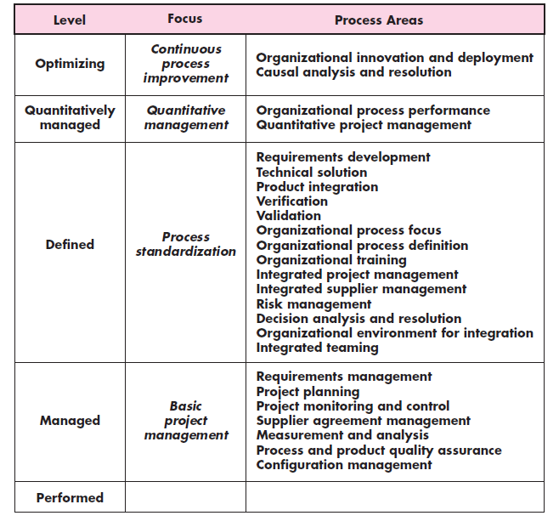
Process area required to achieve a maturity Level

Slide 9
Six Sigma for Software Engineering
Six Sigma is the most widely used strategy for statistical quality assurance in industry today.
the Six Sigma strategy “is a rigorous and disciplined methodology that uses data and statistical analysis to measure and improve a company’s operational performance by identifying and eliminating defects’ in manufacturing and service-related processes”.
The term Six Sigma is derived from six standard deviations—3.4 instances (defects) per million occurrences—implying an extremely high quality standard

Slide 10
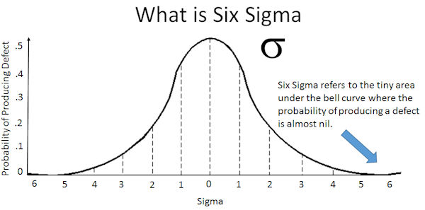

Slide 11
The Six Sigma methodology defines three core steps:
Define customer requirements and deliverables and project goals via well defined methods of customer communication.
Measure the existing process and its output to determine current quality performance (collect defect metrics).
Analyze defect metrics and determine the vital few causes.
If an existing software process is in place, but improvement is required, Six Sigma suggests two additional steps:
Improve the process by eliminating the root causes of defects.
Control the process to ensure that future work does not reintroduce the causes of defects.
These core and additional steps are sometimes referred to as the DMAIC (define, measure, analyze, improve, and control) method.

Slide 12
If an organization is developing a software process (rather than improving an existing process), the core steps are augmented as follows:
Design the process to (1) avoid the root causes of defects and (2) to meet customer requirements.
Verify that the process model will, in fact, avoid defects and meet customer requirements.
This variation is sometimes called the DMADV (define, measure, analyze, design, and verify) method.

Slide 13
Questions
Distinguish CMMI and Six Sigma Method.
Explain various levels of CMMI in detail.
Explain the core and additional steps of Six sigma methodology.
List out specific goals and associated specific practices defined in CMMI.
List out generic goals and practices of CMMI.

